Slide 1


Pump it Up: Data Mining the Water Table
Team members : Naga Santhosh Adaveni , Brian M Keafer ,
Anand Srinivasan.
Course : DSA 5013 Session : Fall 2019.

Slide 2
Agenda
Introduction about the project work
Objective
Data set used
Approach followed
Exploratory data analysis
Data evaluation
Modelling
Summary
Conclusion
Future work

Slide 3
Introduction about the project work :
The Tanzanian Ministry of Water aims at providing potable water at all water points throughout the country.
It is necessary to identify the water points that are functional and the one’s that are not functional so that non-functional one’s can be replaced.
A precise and accurate understanding of which waterpoints will fail can improve maintenance operations and ensure that clean, potable water is available to communities across Tanzania.
A data set has been provided by Taarifa and the Tanzanian Ministry of Water.
The data set provided has variables like kind of pump, year it was installed, and how it is managed etc. There are 39 variables in all. They are numeric, characters as well as factors.
Problem Statement and the Training/Test Data - https://www.drivendata.org/competitions/7/pump-it-up-data-mining-the-water-table/

Slide 4
Objective:
To understand the correlation between variables in data set and develop various regression models with hyper tuning parameters in order to predict the operating condition of a waterpoint for each record in the dataset.
The predicted operating condition needs to be one of the three possible values.
functional - the waterpoint is operational and there are no repairs needed.
functional needs repair - the waterpoint is operational but needs repairs.
nonfunctional - the waterpoint is not operational.

Slide 5
Data set used:
The following set of information has been provided about the waterpoints. Names of all the variables present in the data set and a description of what they stand for has been mentioned below. Some descriptions are quite similar and represent the same data. Only a limited number of variables were used in any given category to avoid multicollinearity when training the model
Location Variables
longitude – GPS coordinate
Latitude – GPS coordinate
basin – Geographic water basin
subvillage – Geographic location
region – Geographic location
region_code – Geographic location (coded)
district_code – Geographic location (coded)
lga – Geographic location
ward – Geographic location
gps_height – Altitude of the well

Slide 6
Data set used:
Operation
scheme_management – Who operates the waterpoint
scheme_name – Who operates the waterpoint
permit – If the waterpoint is permitted
Extraction
extraction_type – The kind of extraction the waterpoint uses
extraction_type_group – The kind of extraction the waterpoint uses
extraction_type_class – The kind of extraction the waterpoint uses
Management & Payment
management – How the waterpoint is managed
management_group – How the waterpoint is managed
payment – What the water costs
payment_type – What the water costs
Quality & Quantity
water_quality – The quality of the water
quality_group - The quality of the water
quantity - The quantity of water
quantity_group - The quantity of water

Slide 7
Data set used:
Source & Kind
source - The source of the water
source_type - The source of the water
source_class - The source of the water
waterpoint_type - The kind of waterpoint
waterpoint_type_group - The kind of waterpoint
Various
amount_tsh – Total static head (amount water available to waterpoint)
date_recorded – The date the row was entered
funder – Who funded the well
Installer – Organization that installed the well
wpt_name – Name of the waterpoint if there is one
num_private –
population – Population around the well
public_meeting – True/False
recorded_by – Group entering this row of data
construction_year – Year the waterpoint was constructed

Slide 8
Approach followed:
Raw Data downloaded
Cleanse Data downloaded
Exploratory Data Analysis
Conclusion
Review of results
Modelling

Slide 9
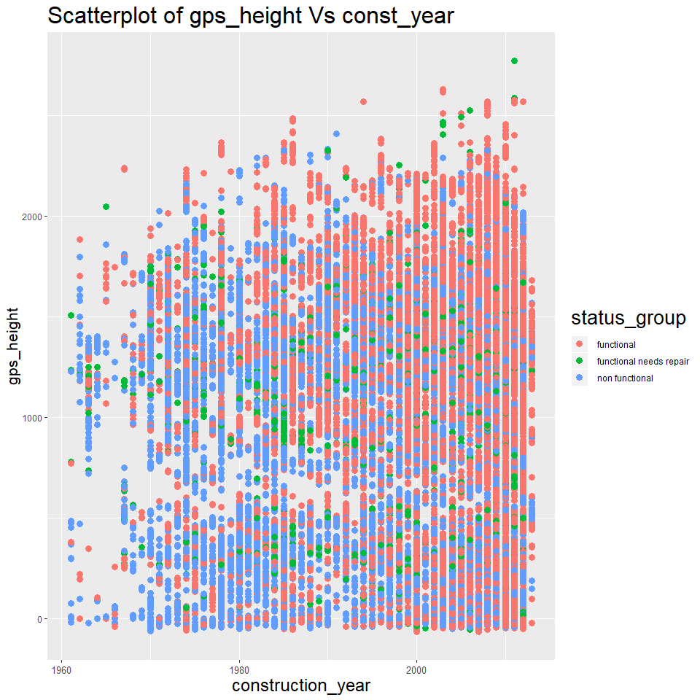
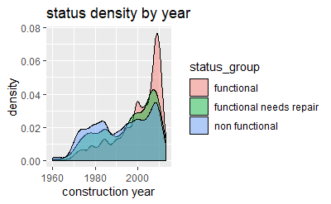
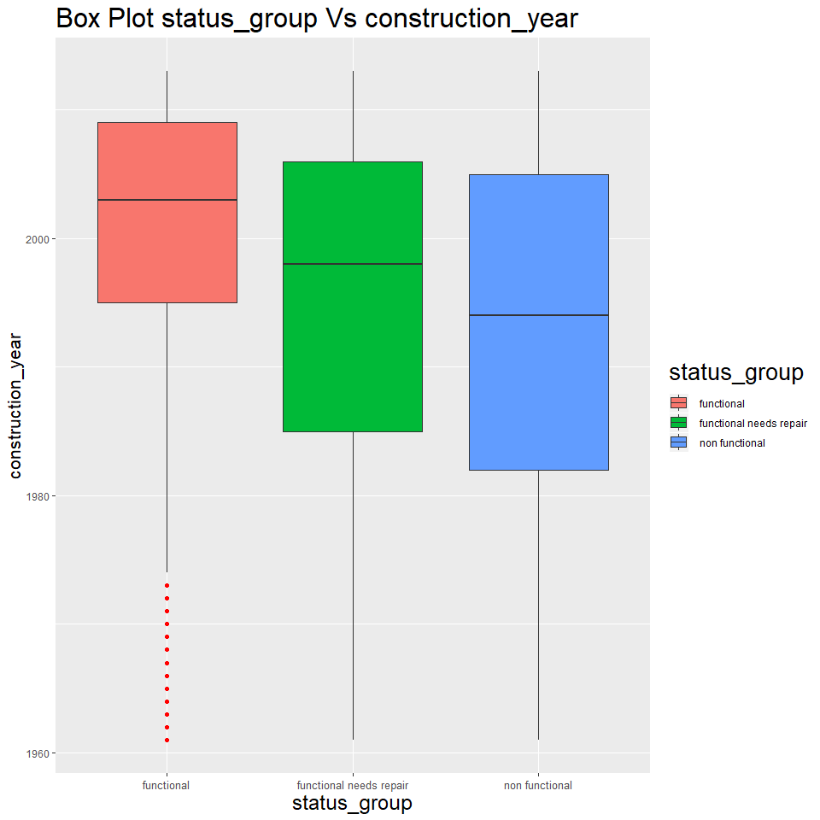
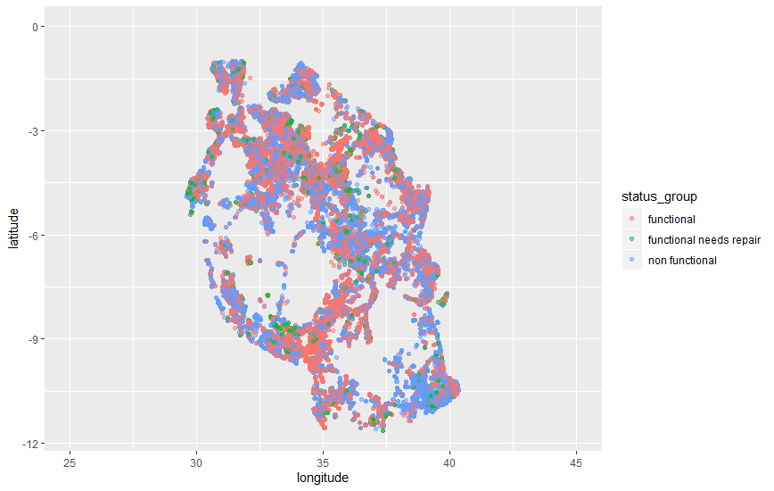
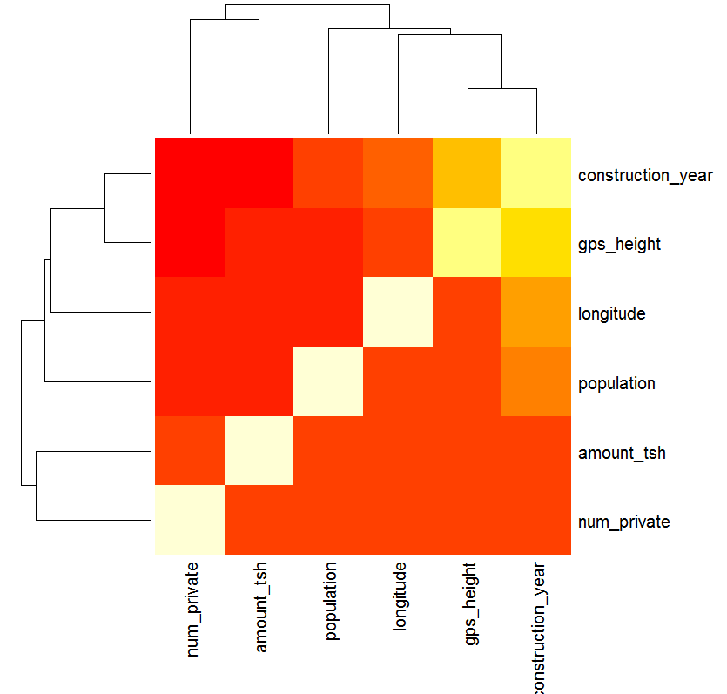
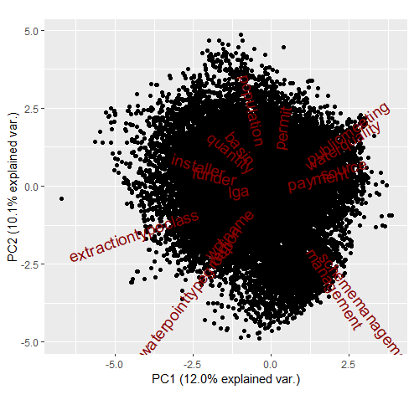
Exploratory data analysis:
Various plots including scatter plots, box plots, bar plots, histograms, pivot tables were created to get a good understanding of the data.
This is an important precursor to the data wrangling step.
Few important plots and all associated inferences are
listed here.
Box cox transformation, Symbox transformation,
Principal component analysis(Bi-plot), Linear discriminant
analysis were carried out but did not provide relevant info.
Heat map was useful to help understand important
correlated variables to start with.

Slide 10
Data evaluation:
Variable names were reviewed replace '_' with '.' in the column names.
Reviewed all the variables to identify and eliminate sparse variables, variables with zero variance, identify duplicated variables and group it to single variable.
Data missingness was found out, missing values imputed as NAVL.
“forcats” was used to lump many variables(Ex) wpt_name-20 levels, population-10 levels gps_height-steps of 300.
Variables with similar information were identified and a single variable from these selected.
The training set was sampled in such a way that it had equal representation of the all the possible factor values. (i.e. 4000 records from each factor).

Slide 11
Modeling:
“Bayesglm” model was used to understand the predictor significance, then identify the right set of predictors. Predictors with low Pr were selected as predictors to proceed further.
The final set of predictors were
amount_tsh, gps_height, longitude, latitude, basin, population, construction_year, extraction_type_class, management_group, payment_type, quality_group, quantity_group, source_class, and waterpoint_type_group.
Naïve Bayes, SVM, MARS and random forest models were trained to predict status group as either functional, non functional, or functional needs repair.
Multiple iterations were done to tune hyperparameters and identify important variables within the most accurate models.
A 70% sample was used to train the data, while 30% was used to test and validate the results

Slide 12
Summary of Results:
The random forest model proved to provide the most accurate measurement of accuracy. This is due to it’s increased complexity and unique way of dealing with predictors with multiple factor levels.
Model | Method | Package | Hyperparameter | selection | CV performance
 |  |  |  |  | Accuracy | Kappa
Penalised logreg | glm | nnet | NA | NA | 0.5046 | 0.2290
Naïve bayers | naive_bayes | naivebayes | NA | NA | 0.5182 | 0.2840
Support vector machines | SVM | e1071 | NA | NA | 0.6234 | 0.3894
Random forest | rf | randomForest | mtry | 8 | 0.7981 | 0.5956

Slide 13
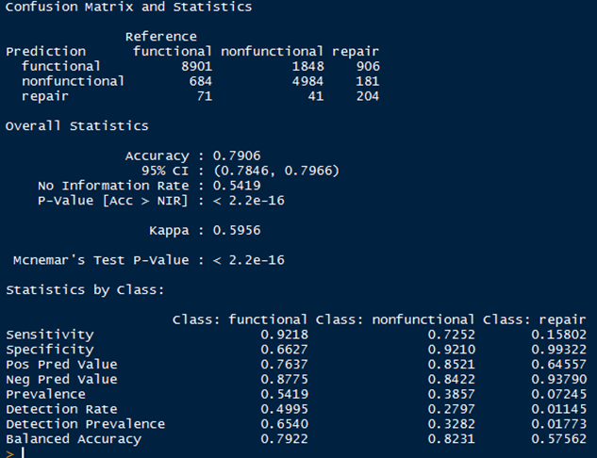
Random Forest Model Validation:
The results of random forest modeling is displayed to the right, it includes the confusion matrix and other metrics
79.06% accuracy is quite good, especially compared to the 54.19% No Information Rate. This represents a nearly 25% increase in correct classification as compared to only knowing the distribution of the dataset
The kappa value at 59.56%, which is observed value with expected random chance, is well over 50%
However….the sensitivity, detection prevalence, and balanced accuracy of the class “repair” and to a lesser extent “non functional is lacking”
These classes are more prevalent in identifying so that they can be fixed, they need to be more represented in initial model training.

Slide 14
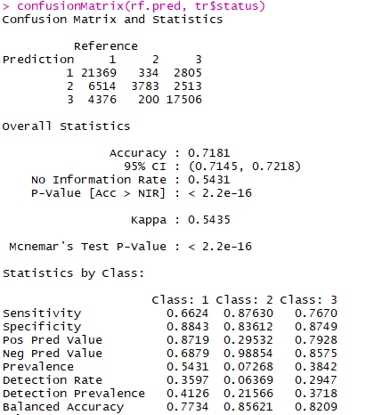
Random Forest Model Selected Sample Validation:
The results of the same random forest model applied to a selected sample, containing 4000 instances of each status group is seen to the right.
The overall accuracy has been compromised by about 8%
However, the kappa metric has decreased only slightly
Most significantly, the additional metrics including sensitivity, specificity, and balanced accuracy as applied to ‘non function” and “repair” classes has increased at a drastic rate.
It is important these classes are identified as compared to the more populous “functional’ class because these classes have a call to action associated with them.
Repair or non function means maintenance or total reconstruction is needed. The source is currently without water or will soon be.

Slide 15
Variable Importance:
Geographic location (latitude and longitude) was of increasing importance in all models. The exact measurement of point in area allowed models to pinpoint, rather than be “hand-cuffed” by factor levels.
Construction Year, specifically after 1960 was a leading indicator of functional water points. It would be safe to assume construction methods were improved over time. Additionally, it would be common sense to think older water points may decay with heavy use
Amount_tsh is an indicator of water flowing through each point. The predictor treated as a variable allowed a more precise measurement in modeling.
Group specific:
The quantity group “enough” indicated a functional water point, but seasonal was an indication of needing “repair” and insufficient indicated a “non functional” point
Payment type “never” indicated the site would was “non functional”
Each grouping played a pivotal roll in classifying the water point as one of the group status variables, this lended itself to the success of random forest modeling quite well.

Slide 16
Conclusion:
Random Forrest modeling provided the most accurate classification rate of the status group of each well
Functional was most present status group of the dataset and was predicted at the highest rate
Unnecessary predictors or predictors with too much or too little variance created too much noise to train an accurate model efficiently
The random forest model with highest accuracy was not indicative of what the goal of the predictive modeling project was about
The goal is to identify the status group so that well in need of repair or non functional can received the support needed, without having to check ever well manually.
A high accuracy rate for functional wells may look good on surface, but a false positive is worst than a false negative in this case.
A selected sample providing a larger representation of non functional and repair water points increased the classification rate of these 10 fold, while decreasing overall model accuracy minimally.
Overall, location, usage rate, and various group type were the most important indicators of the water point status group

Slide 17
Future work:
Equipment failure/maintenance prediction is one of the challenging tasks in all industries.
Future work objective is to further generalize this work to better predict equipment failures, equipment of different types and from different conditions before it happens. This study is a prediction of current status, and lacks the insight to prevent a non functional status in the future.
This would entail needing different set of routines written to modularize the work for different kinds of equipment.
This would also require time series data on each water point
Neural Networks or boosted random forest may be future modeling techniques that could achieve more accurate results, especially if more equipment type and time series data is provided

